Slide 1


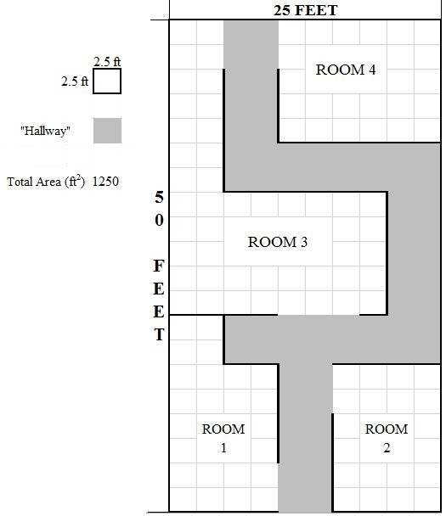
FlyNet: End of Semester Test
Setup:
Known blueprint of area
Set up in Fleming Vicon Cage
Multiple rooms
Includes various hallway types
Dead end
Left turn
Right turn

Slide 2
FlyNet: End of Semester Test
Unknowns:
Three “Roadblocks” placed into map
4’ x 3’ wall
Placed into map
“Target” placed into map
One “Complete Block” placed into map
4’ x 6’ wall
Height of standard wall for test environment
“Roadblock”
“Target”
“Complete Block”

Slide 3
FlyNet: End of Semester Test
Tasks to Complete:
Explore entire map
Avoid all obstacles
Walls
“Roadblocks”
“Complete Blocks”
Return back to Entry Point with entire area mapped
“Roadblock”
“Target”
“Complete Block”
Entry/Exit Point

